Slide 1

The NewsEra App Design
Assessment-1.2
Submitted By: Manisha Jaiswal
ID: 20159408 (Group- 1C)
Course: Masters Advanced Computer Science
Sub: Advanced Mobile Computing
Dated: 21/05/2021

Slide 2
The NewsEra App Overview
In this, my aim is to design a NewsEra App for the both Android and iOS Platforms using React-Native and API.
Here, the user can able to watch currently news about their interest (e.g. sports, business, entertainment, etc).
In my application the user can able to watch news online about their interest.

Slide 3
Overall App Structure
Base Class: used by React Native
Components
Fetch News file:
.Js file
Header file:
.Js file
Modal News file:
.Js file
Card News file:
.Js file
JS file
JSON package
Media
Title
Category
News
Current()
Watch()
Link Copy
Global
Private
app.json
app.js
css.js
package.json
babel.config.js
Package-lock.json

Slide 4
Overall App Structure
In the above slide displays the overall structure of the App “The NewsEra App”:-
There is a screen in the app: Navbar and Cards which contains four components file as fetch_news, header, modal_news and card_news and read_more. It displays all list of current news in a flatlist.
All news access online through Api and always display updated news.

Slide 5
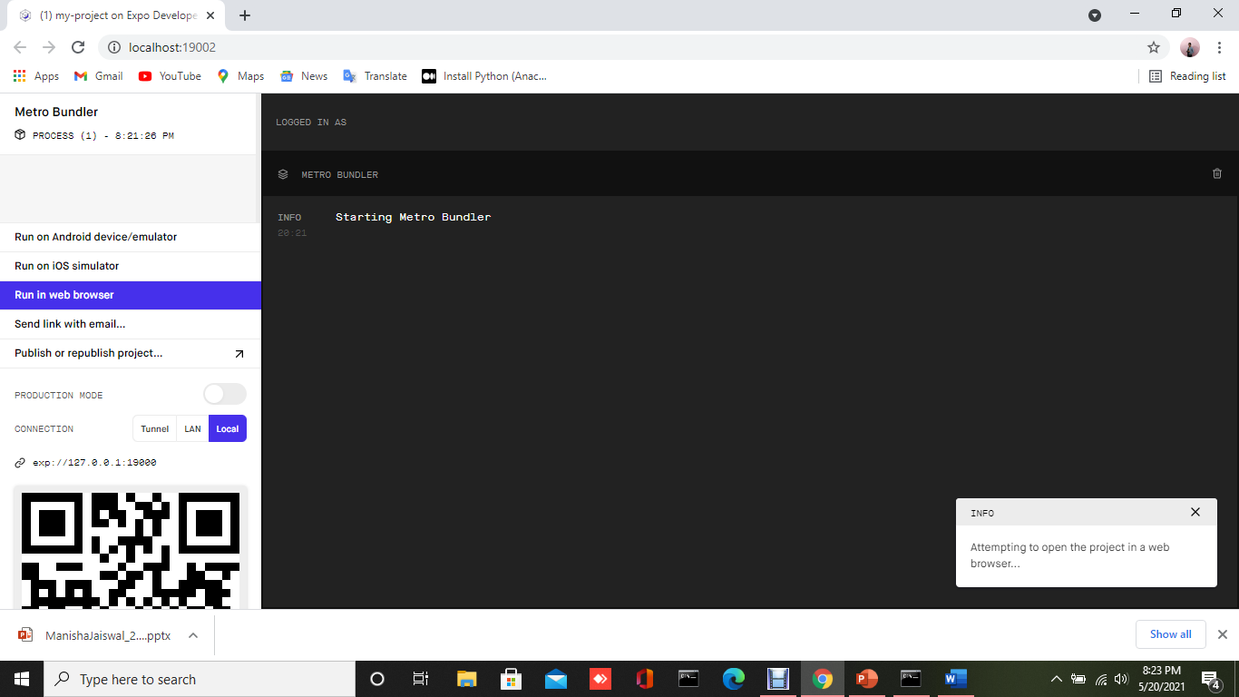
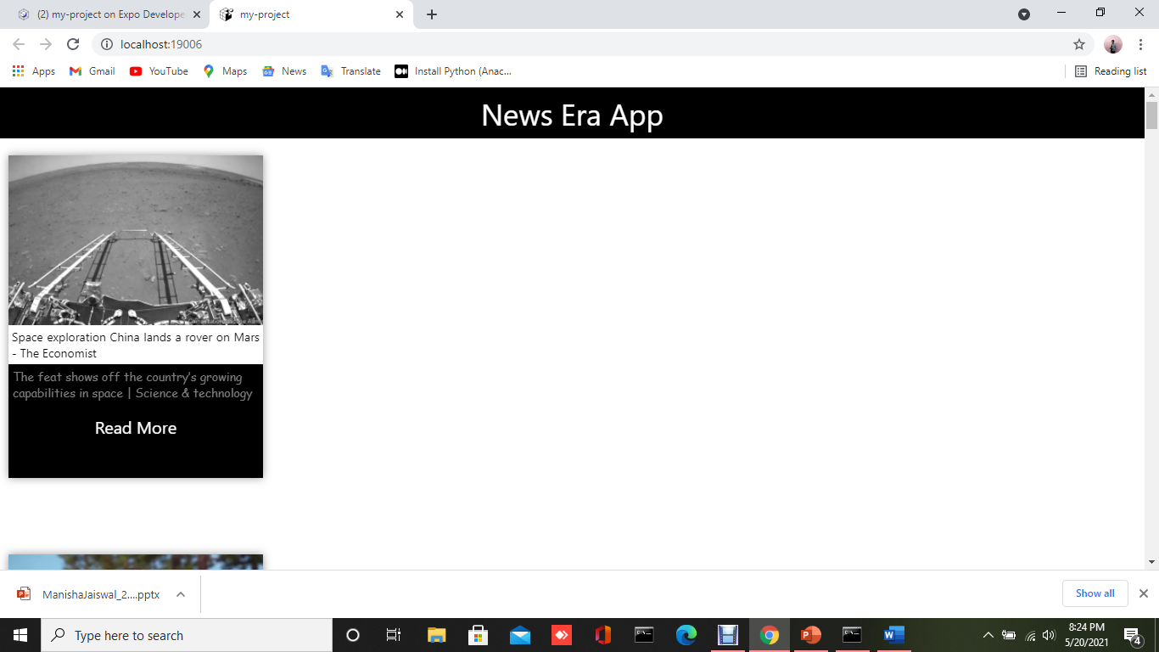
User Interface Implementation(on Local-host)

Slide 6
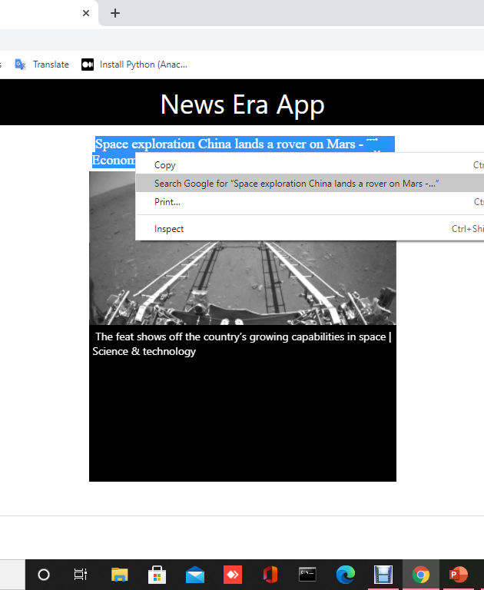
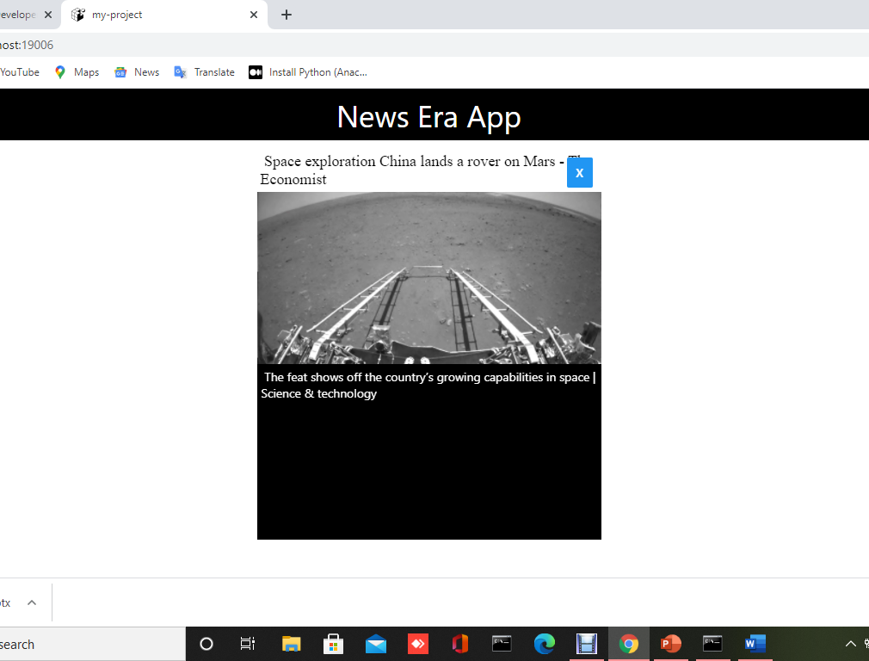
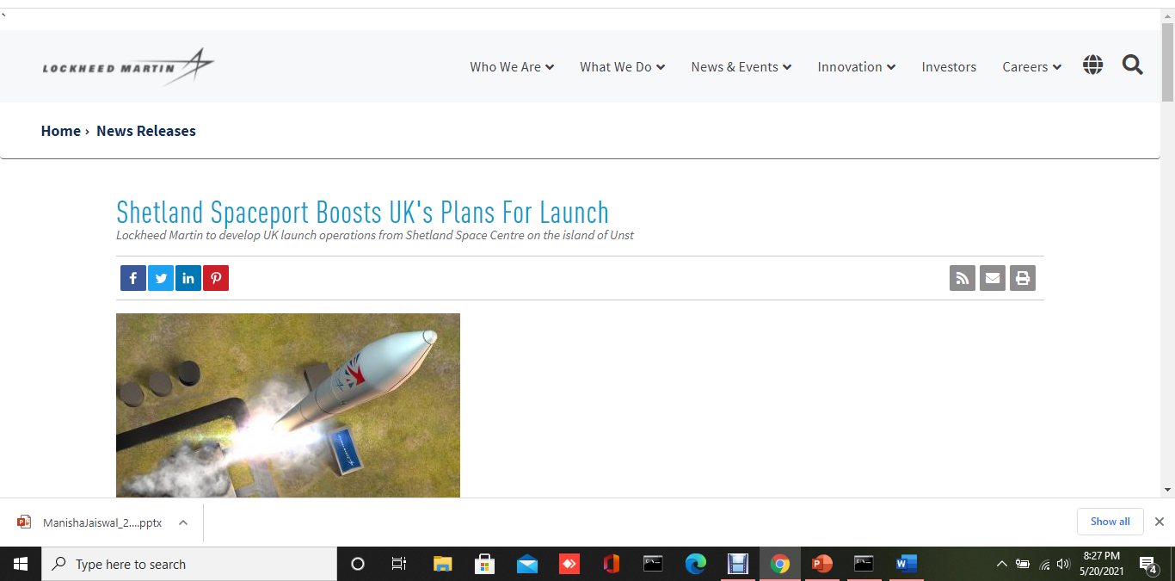

Slide 7
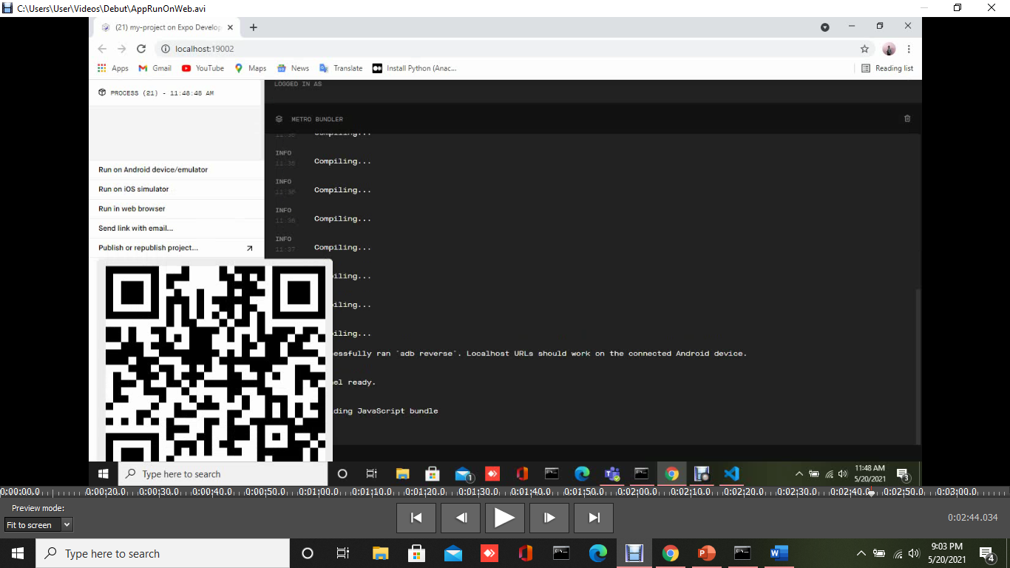
Tunnel is Started on Local-host

Slide 8

User Interface Implementation-UI Demo(video capture)

Slide 9
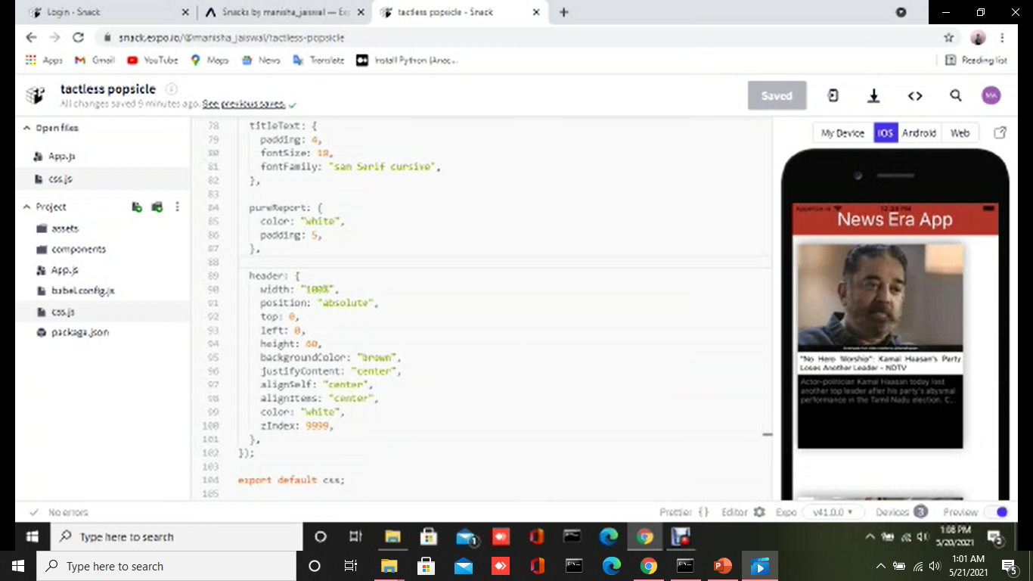
User Interface Implementation-ios Demo(video capture)

Slide 10
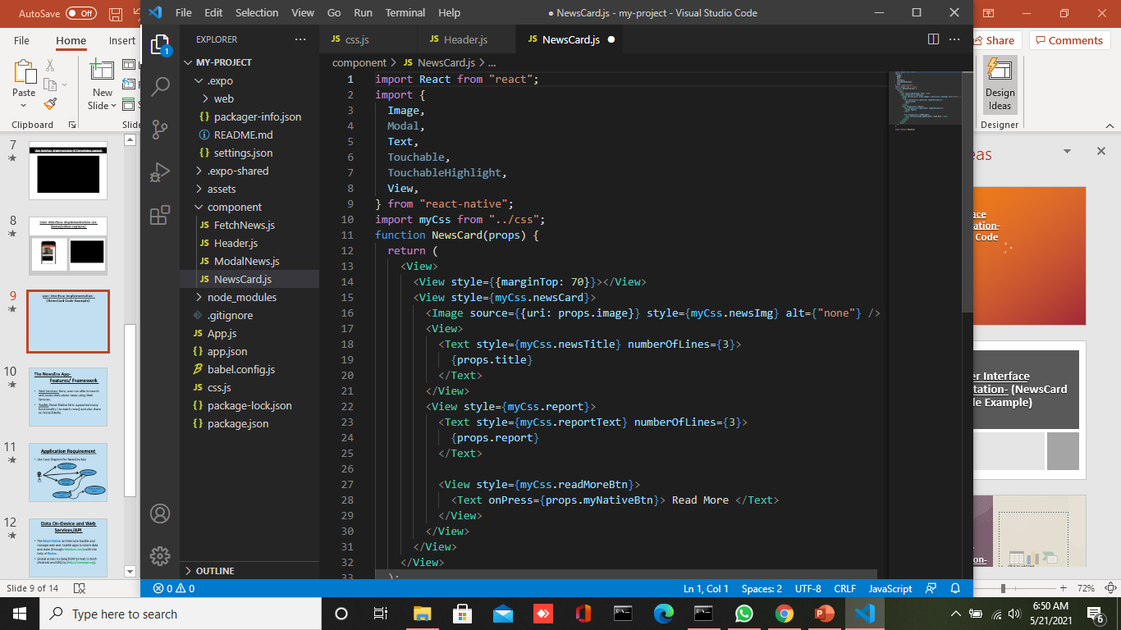
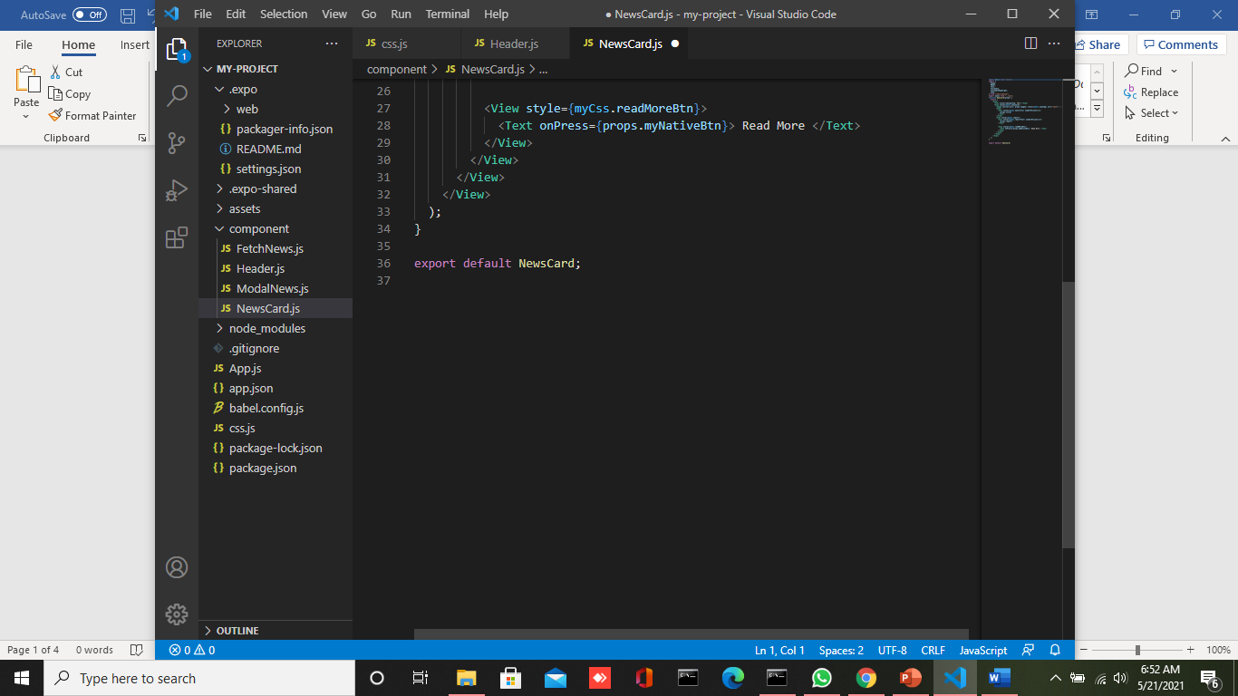
User Interface Implementation- (Code Example of News_Card)

Slide 11
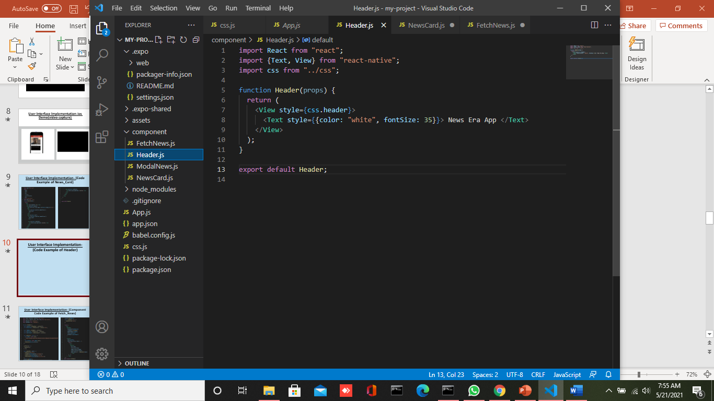
User Interface Implementation- (Code Example of Header)

Slide 12
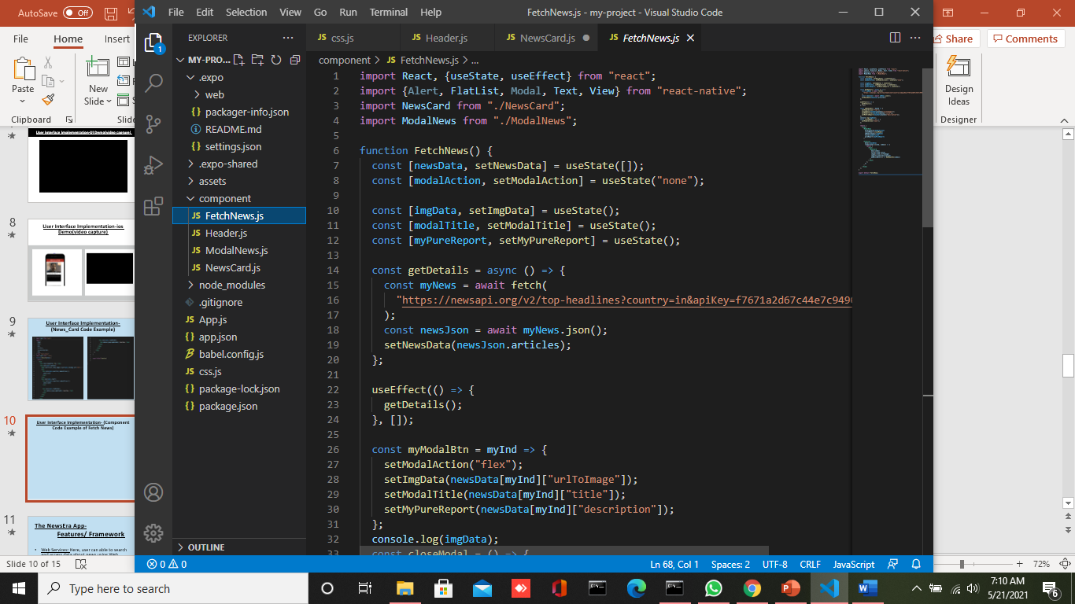
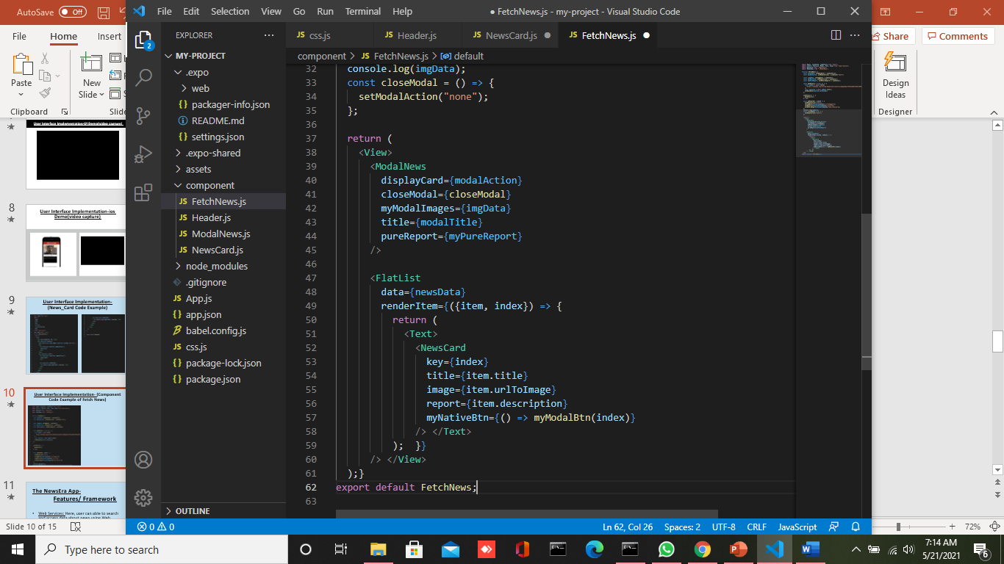
User Interface Implementation- (Component Code Example of Fetch_News)

Slide 13
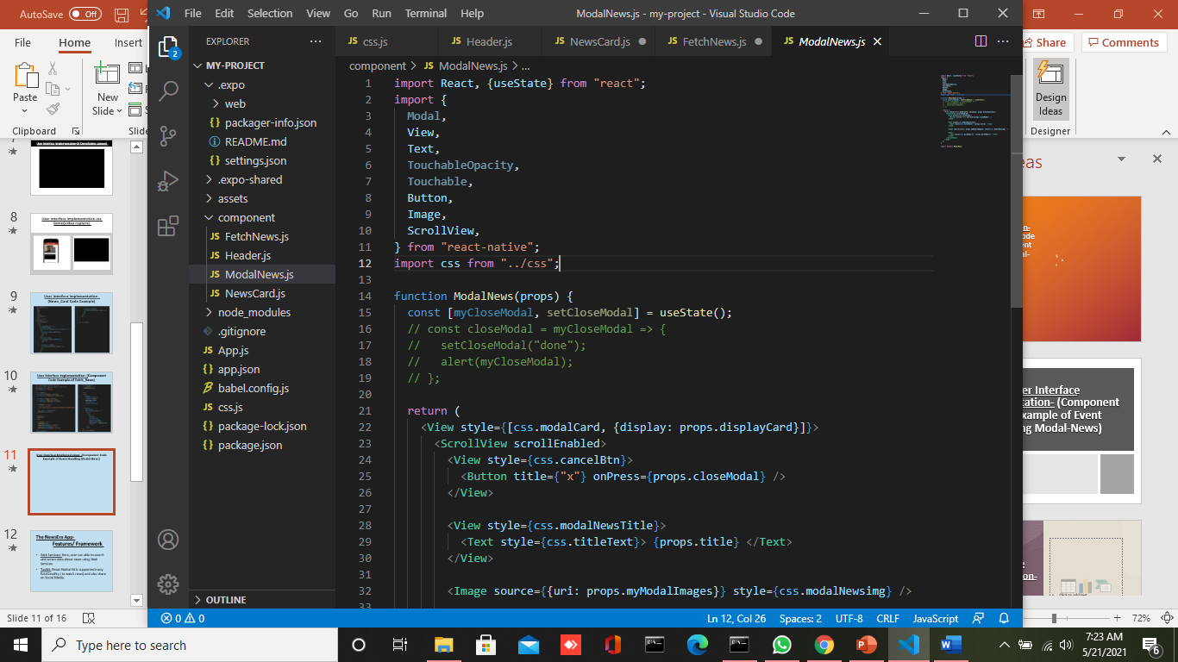
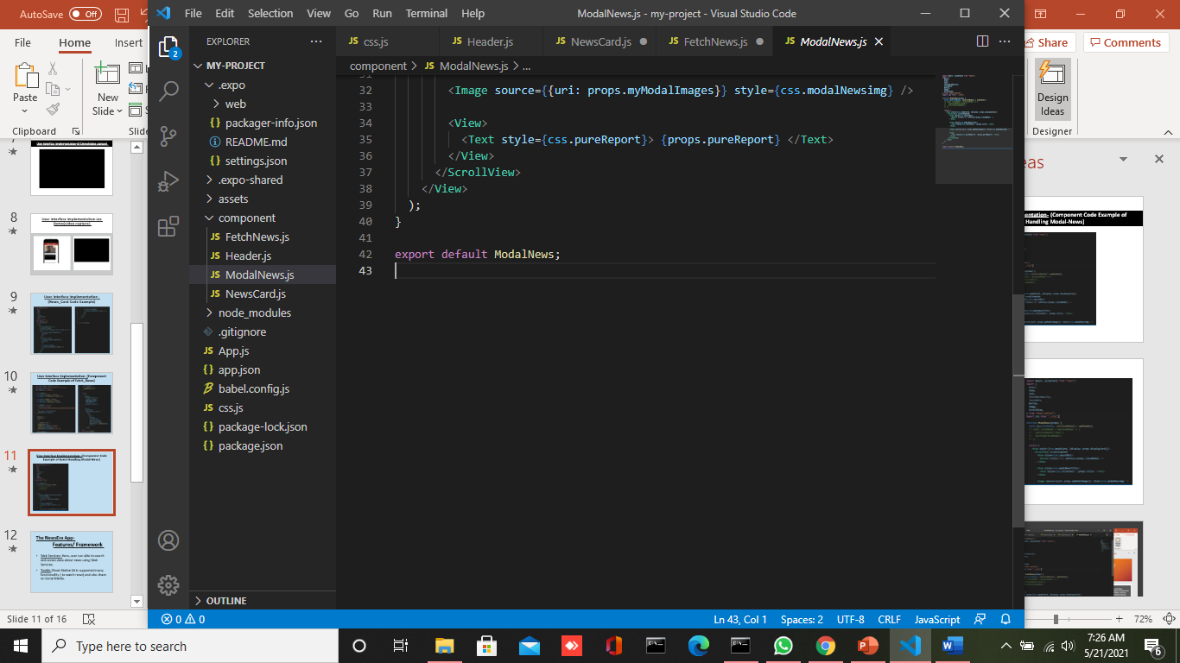
User Interface Implementation- (Component Code Example of Event Handling Modal-News)

Slide 14
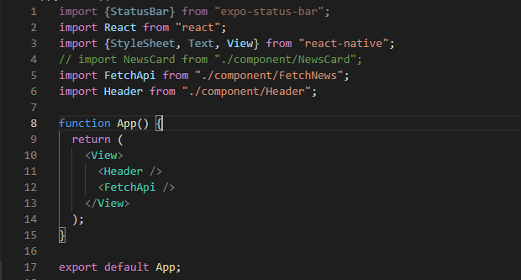
Data Persistence Implementation- (code Example)

Slide 15
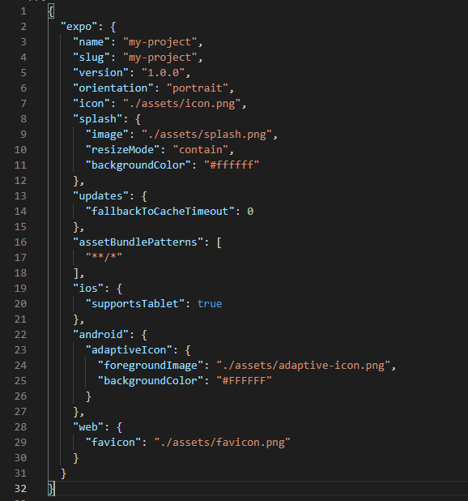
Web Services Implementation- Code Example

Slide 16
Data On-Device and Web Services/API
The React-Native architecture handle and manage web and mobile apps to share data and state.
Global access to data(JSON format) in both (Android and iOS) by (http://newsapi.org).

Slide 17
Presumption and Provocation
Here, using of React-Native will be more challenging (Cross-platform).
Perhaps, to download and display of images and news from services will be provocation (especially local persistence/ Tunnel.
Maybe, deal with Web Services can more challenging.
Note: Not able to add any additional frameworks due to time limitation.

Slide 18
Thank You!
(Any Question Please)
?

